Slide 1

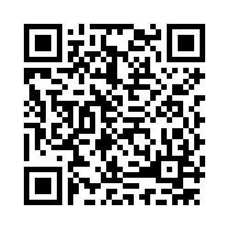
DS 1002: Programming for Data Science w/ Prof. Natalie Kupperman
If you haven’t already, please fill out the pre-class survey.
Link available in Collab under ”Syllabus”

Slide 2
DS 1002: Programming for Data Science
Class 1 - Getting Started
Fall 2022

Slide 3


About the Instructor
Natalie Kupperman (Cup-er-man) (she/her/hers)
PhD in Kinesiology – Sports Med (double Hoo!)
Got into data science through Sports Science/Biometrics
Trained as an Athletic Trainer – worked clinically for 8 years

Slide 4

About the TA
Zeyu Mu (she/her/hers)
Second year PhD student in
system engineering
Research in intelligent transportation
Skills: Python, Matlab, C++, R
Love skiing

Slide 5
Introduce Yourself
Major
Year

Slide 6
Pre-class Survey
Please complete by August 28th

Slide 7
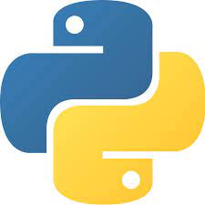
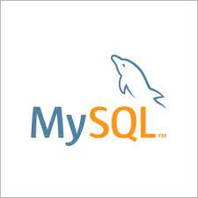

Languages
Python – 1/2
SQL – 1/4
R- 1/4

Slide 8
Commuting Environments
Why commuting environments? Why not the command line?
CEDS - Let’s log in together

Slide 9
Tech Stack
Jupyter Notebooks
R Studio
SQL Workbench
Git/Github
Command Line (terminal, gitbash, command prompt)

Slide 10
Syllabus
Please read the syllabus in its entirety.
Understand the syllabus is a dynamic document which may change throughout the semester. Updates to the syllabus will be announced in class and on Collab.

Slide 11
Let’s Get Started

Slide 12
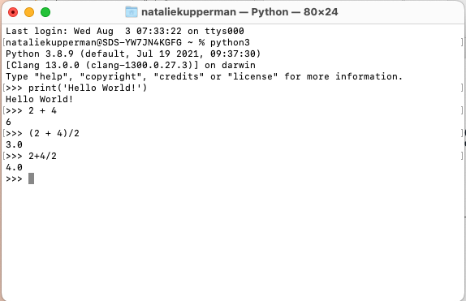
Command Line
You can run Python from the command line

Slide 13
Command Line Basics
Command | Process
ls | list files in a directory
ls -l | list detailed
cd | move to directory
pwd | print working directory
~ | home directory
.. | move up one directory
mkdir | make directory
clear | removes all code up to top
mv | rename file
rm | remove file
cp | copy file

Slide 14
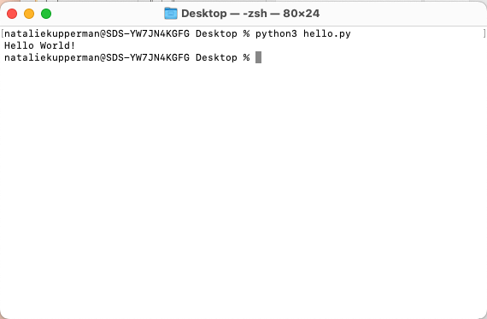
Running Scripts
You can run Python from the command line using a .py script
When running a script, python is acting as an interpreter
Different interpreters (e.g. Cpython, Jython, PyPy) handle different coding languages

Slide 15
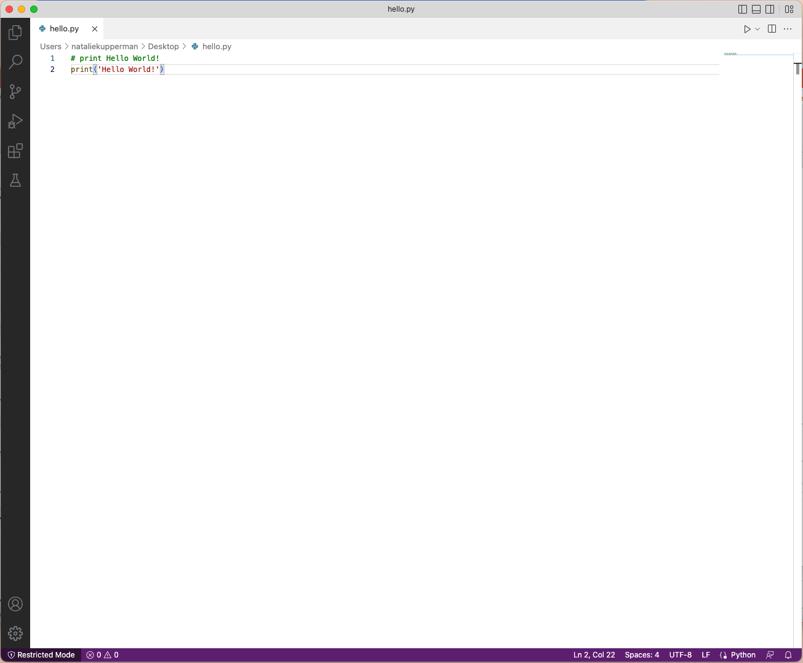
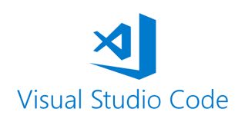
Writing Scripts
Scripts are usually written in a text editor like Visual Studio (VS) Code, TEX, or notepad
Python scripts use the extension .py
Visual Studio Code is also an IDE (integrated development environment)

Slide 16
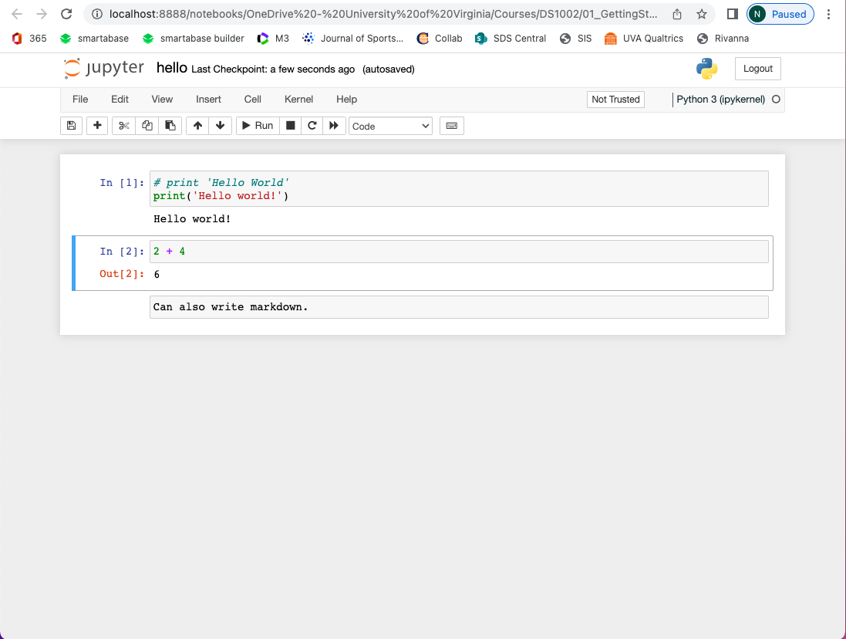

Jupyter Notebook
Jupyter Notebooks is another IDE and great for learning to code
In this class, we will spend most of our time in Jupyter Notebooks

